Slide 1
Big Data Analytics with Spark and Scala

Slide 2
Course goal
Train students to kick start their journey with Big Data Analytics with Apache Spark with simple explanations and easy to do exercises

Slide 3
Why learn Apache Spark?
Hottest tool /product in the Big Data Analytics field.
Used by more and more companies for Analytics and Machine Learning
Hadoop/Map Reduce applications migrating to Spark
More and more third party support
Huge current and forecasted demand for skilled professionals

Slide 4
What you achieve by taking this course
Understand the concepts and life cycle of Data Science and Analytics
Develop proficiency to use Apache Spark for all stages of analytics
Learn Data Engineering tools and techniques with Spark
Acquire knowledge of different machine learning techniques and know when and how to use them.
Become a full-fledged Big Data Analyst who can immediately contribute to real-life Analytics projects

Slide 5
Course Structure
Hadoop and Spark Concepts
Interactive Programming with Scala
Spark Programming including Spark SQL and Spark Streaming
Basics of Real Time Data Science
Machine Learning with Spark
End-to-End use cases
Resource Bundle

Slide 6
Things not covered
Object Oriented Scala
Spark Cluster setup and administration
Running Spark on a cluster

Slide 7
Guidelines to students
Machine Learning and Data Science is a complex subject. Needs significant efforts to understand it.
Review and re-review videos and exercises
Seek out other help – books, online documentations, support forums
If you have queries, doubts or concerns, please send a private message or post a discussion question
We would be happy to address them as soon as possible
We are constantly improving our courses so all feedback is welcome
Feedback through private messages / emails.
At the end of the course, if you like it, please leave a review

Slide 8
Relationship with other V2 Maestros courses
Our courses are focused on Data Science related topics
Technologies
Processes
Tools and Techniques
We focus on making our courses self sufficient
If you are an existing V2 Maestros student, you will see some content and examples repeated across courses

Slide 9
We hope this course helps you to advance your career.
Best of luck !

Slide 10
Hadoop Technologies
Overview

Slide 11
Big Data & Hadoop Overview

Slide 12
What is Big Data?
Broad general term for data sets so large and complex that traditional data processing and storage techniques are inadequate
Traditional RDBMS and business applications
Volume ( TB, PB)
Variety ( web, photo, video, audio, unstructured data, mobile, social)
Velocity (batch, periodic, real time)
Veracity (quality of data – dirty)

Slide 13
Why Big Data
Web and Cloud applications created the need to store and process huge amounts of data
Traditional RDBMSs do not fit the role
Only good for numbers, structured and clean data
Scaling required very expensive hardware
Fault tolerance was again expensive
Existing processing techniques cannot scale without extensive code development

Slide 14
Evolution of Big Data (Hadoop)
2002 - Doug Cutting and Mike Cafarella start working on Nutch
2003 – Google publishes GFS & MapReduce
2004 – Doug Cutting adds GFS & MR to Nutch
2006 – Yahoo hires Doug Cutting and Hadoop is created
2008 – Applications of Hadoop start to emerge
2009 – New companies which built on Hadoop start to emerge
Hadoop and its eco-system starts to grow and expand

Slide 15
What is Hadoop ?
Doug Cutting named his product as “Hadoop” based on the name of a an elephant toy which his kid named as Hadoop
The Hadoop product consist of 2 components
Hadoop Distributed File System (HDFS)
Map Reduce Programming Paradigm
Hadoop forms a “platform” on which a number of applications are built.
Data Ingestion, Processing and Analytics

Slide 16
Things about Hadoop
Unix based (no windows support)
Built using Java
Not much UI. Most actions are command line based.

Slide 17
Setting up your Hadoop Environment
If you already have a Hadoop setup, you can skip this section.

Slide 18
Cloudera QuickStart VM
Single box installation containing running instances all Hadoop components
Linux based. (! ☹ ). Linux familiarity is a pre-requisite.
Hadoop in general is not that user friendly (for folks used to windows)
Minimum 4 GB. Need 8 GB for good response times.
Can be installed as a VM on windows
Downloads & setup instructions available at
http://www.cloudera.com/content/cloudera/en/documentation/core/latest/topics/cloudera_quickstart_vm.html

Slide 19
HDFS

Slide 20
Features of HDFS
Another “Distributed File System”
Files and Directories.
Optimized for very large files ( TB, PB)
Optimized for write-once, read-many
Fault-tolerance by default. No backups required.
Data replication happens all the time.
Runs on commodity hardware
Moves code to where data resides

Slide 21
HDFS Architecture
Master Slave architecture
Built as a HDFS Cluster. Each cluster has one to many nodes.
One “NameNode” per cluster (Master)
Master who manages the cluster
Maintains meta-data about the entire cluster
Allocates work to data nodes
One “DataNode” per node (Slaves)
Storage, and read-write operations

Slide 22
Storing files in HDFS
Files split up as data blocks (64 MB size by default)
Each block is replicated across multiple data nodes ( 3 copies )
NameNode maintains list of blocks that makes up a file.
File writes (only create, no update)
Client contacts NameNode for destination to write
NameNode provides list of DataNodes to write to.
Client writes directly to the DataNode.
File reads
Client contacts NameNode for list of blocks and locations
NameNode returns the list
Client reads directly from the DataNodes
HDFS Storage is “rack-aware”

Slide 23
HDFS Architecture
my Very Big File | B1 | DN-1,DN-2,DN-4
 | B2 | DN-1,DN-3,DN-5
 | B3 | DN-2,DN-3,DN-4
Client
Name Node
Rack 1
Rack 2
DN-1
DN-2
DN-3
DN-4
DN-5
B1
B1
B2
B1
B2
B2
B3
B3
B3

Slide 24
Map Reduce

Slide 25
Map Reduce Overview
A new programming paradigm built to exploit the parallel nature of HDFS data.
Batch mode execution.
Moves program code to data nodes.
Multiple Map Reduce jobs can be chained to create a larger solution
Designing jobs require thinking in Map Reduce paradigm

Slide 26
Map Reduce components
Map Reduce jobs are executed using the Job Manager and the Task Manager.
Job Manager runs on the NameNode.
“Plans” the execution of the job on the task managers
Works with the NameNode.
Returns results to client
Task Managers run on each of the Data Nodes
Executes the map and reduce functions.
In YARN (Map Reduce v2), the function of the job manager is split between the Applications Manager and the Resource Manager.

Slide 27
What is Map and Reduce
Map
A Function (a program)
Works on 1 line of the file at a time
Output is keys and values.
Reduce
A function
Works on one key at a time.
Output is key and values.

Slide 28
How it works - Input
Map Function
Reduce Function
Files containing the map and reduce functions
Input HDFS directory
Output HDFS directory

Slide 29
How it works - Splits
The input data is split into “splits”. A split is a copy of contiguous HDFS blocks of data in the input file.
Each split exists on a specific data node.
The client (client library/ command line) copies the files containing the map function to each data node identified.
The data node should contain execution capabilities for the code file.
The local Task Manager process then executes the map function. Multiple such processes will run in parallel on different splits

Slide 30
How it works – Map function
The Task Manager iterates over each line in the input split and passes it to the map function.
The “map” function is called for each input line.
The line is of “Text” format
It is the responsibility of the Map function to interpret / split / convert / process the line.
Typical functionality of Map functions include Data Cleansing and Filtering
Map function should not work “across” lines.
Map outputs key-value pairs as output.
Each run can output the same key multiple times.

Slide 31
How it works – merge / sort
Sort and merge is done by Hadoop
The outputs of all map executions from different DataNodes are merged.
This merged data is sorted by the keys
Values for the same key are then converted to a list.
This <key,value list> then becomes the input for the reduce function.

Slide 32
How it works – Reduce function
Typically there is only one reduce execution.
Input is the <key, value list> from the sort/merge operation. It is iterated key by key.
Reduce function called once for each key.
Typical usage is summarization, analysis, joins etc.
Reduce functions can work across multiple keys.
Multiple reduce executions can be used if operations are limited to keys. Data is split by keys between multiple reduce instances.
Output of the reduce function is placed in the output directory.

Slide 33
Map Reduce Execution
Node 1
Merge & Sort
Split 1
Map
Out 1
Node 2
Node 4
Split 2
Map
Out 2
Merge
Reduce
Result
Node 3
Split 3
Map
Out 3

Slide 34
Map Reduce Example
Input : Score sheet of soccer games for a team
Game=17,Date=230515,Goals=3,Ben=2,Tom=1
Game=18,Date=240515,Goals=1,Mike=1
Game=19,Date=250515,Goals=2,Ben=1,Mike=1
Game=20,Date=260515,Goals=1,Ben=1
Game=21,Date=270515,Goals=4,Tom=3,Mike=1
Game=22,Date=280515,Goals=1,Mike=1
Program output : Total goals by player

Slide 35
Example Program Flow
Node 1
Ben,2
Tom,1
Mike,1
Game=17,Date=230515,Goals=3,Ben=2,Tom=1
Game=18,Date=240515,Goals=1,Mike=1
Map
Node 4
Node 2
Ben,1
Mike,1
Ben,1
Game=19,Date=250515,Goals=2,Ben=1,Mike=1
Game=20,Date=260515,Goals=1,Ben=1
Ben, (2,1,1)
Mike, (1,1,1,1)
Tom, (1,3)
Ben,4
Mike,4
Tom,4
Map
Reduce
Node 3
Tom,3
Mike,1
Mike,1
Game=21,Date=270515,Goals=4,Tom=3,Mike=1
Game=22,Date=280515,Goals=1,Mike=1
Map

Slide 36
Hadoop Stack

Slide 37
Hadoop Technology Stack
Custom MR
Mahout
Hive
Pig
Flume & Sqoop
Impala
Spark
HBase
Storm
Zookeeper
Oozie
Map Reduce
HDFS

Slide 38
Apache Spark

Slide 39
Introduction to Spark

Slide 40
What is Apache Spark
http://spark.apache.org/
A fast and general engine for large-scale data processing
A Open-source cluster computing framework
End-to-End Analytics platform
Developed to overcome limitations of Hadoop/Map Reduce
Runs from a single desktop or a huge cluster
Iterative, interactive or stream processing
Supports multiple languages – Scala, Python, R, Java
Major companies like Amazon, eBay, Yahoo use Spark.

Slide 41
Advantages of Spark
A fast-growing Open Source engine
Many times faster than map-reduce
Keeps data in memory
Runs alongside other Hadoop components
Support for many programming languages
Scala, R, python, Java, piping
Same functionality across multiple languages
Multiple options and libraries – Graph, SQL, ML, Streaming
Workings with multiple management frameworks

Slide 42
Spark Use Cases
Data Integration and ETL
Interactive Analytics
High Performance Batch computation
Machine Learning and Advanced Analytics
Real time stream processing
Example applications
Credit Card Fraud Detection
Network Intrusion Detection
Advertisement Targeting

Slide 43
Typical Spark workflow
Load data from source
HDFS, NoSQL,S3, real time sources
Transform Data
Filter, Clean, Join, Enhance
Store processed data
Memory, HDFS, NoSQL
Interactive Analytics
Shells, Spark SQL, third-party tools
Machine Learning
Action

Slide 44
Online Reference
http://spark.apache.org

Slide 45
Scala Programming

Slide 46
Introduction to Scala

Slide 47
Expectations for this module
Introduces basic programming constructs for Scala
Focuses on interactive programming
Common use case addressed is for interactive analytics
Does not cover Object Oriented programming.
Recommended to use other Scala sources to learn about advanced topics.
http://www.tutorialspoint/scala

Slide 48
Scala Overview
Scala stands for “Scalable” Language
Runs on JVM
High performance
Statically typed, flexible syntax
Multi-paradigm : Interactive, functional and object oriented
Interoperability with java

Slide 49
Setting up Scala
Java is a pre-requisite
Download from http://www.scala-lang.org/download/
Installer sets up Scala on windows
Can access the shell by typing “scala” in command prompt

Slide 50
Language Basics

Slide 51
Values and Variables
Values are immutable – they cannot be changed once created.
val myValue = 1
val myNumber: Int = 2
Variables are mutable – they can be changed after creation
var myVar = 1
var myString: String = “hello”
Value and variable names can use letters, numbers and some special characters

Slide 52
Data types
Numeric types – Byte, Short, Int, Long, Float, Double
Char represents a single Unicode character
String data type represents strings of text
Boolean data type takes “true” and “false”
“Null” can be used to represent no value

Slide 53
Operators
Arithmetic
+, -, *, /, %
Relational
==, !=, <, >, >=, <=
Logical
&&, ||, !
Assignment
=, +=, -=, *=, /=, %=

Slide 54
Conditions
If – else
if ( a > b) {
do something
}
else {
do something else
}
Match (similar to switch)
val myvar = empCount match {
case 1: …
case 2: …
case _ : …
}

Slide 55
Looping
While
while ( mycount < 100) {
….
}
For loop
for ( x <- 1 to 10 ) {
….
}

Slide 56
Functions
def computeSum( x:Int, y:Int) : Int = {
return x+y
}

Slide 57
Collections
Arrays
Sequencial list of values of same type. They are mutable
Index starts from 0
val x:Array[String] = Array (“fed”,”sam”,”Christie”)
x(0)
Lists
Sequencial list of values of same type. They are immutable
Index starts from 0
val y:List[Int] = List(5,6,10)
y(0)

Slide 58
Collections - 2
Tuples
An ordered container of two or more values
Index starts from 1
Values can be of different types
val employee = (1001, ”Derek Smith”, false )
emp._1
Map
Stores key-value pairs
val employee = Map(“id” => “1001”,”name” -> “Derek Smith”,
married -> “false”)
employee(“id”)

Slide 59
Spark Architecture

Slide 60
Spark Framework
Scala
Python
R
Java
Tools
Programming
Library
Spark SQL
ML Lib
GraphX
Streaming
Engine
Spark Core
Management
YARN
Mesos
Spark Scheduler
Storage
Local
HDFS
S3
RDBMS
NoSQL

Slide 61
Resilient Distributed Datasets (RDD)
Spark is built around RDDs. You create, transform, analyze and store RDDs in a Spark program.
The Dataset contains a collection of elements of any type.
Strings, Lines, rows, objects, collections
The Dataset can be partitioned and distributed across multiple nodes
RDDs are immutable. They cant be changed.
They can be cached and persisted
Transformations act on RDDs to create a new RDD
Actions analyze RDDs to provide a result

Slide 62
Spark Architecture
Worker Node
Master Node
Executor
Task
Cache
Driver Program
Spark Context
Cluster Manager
Worker Node
Executor
Task
Cache

Slide 63
Spark scalability
Single JVM
Runs on a single box (Linux or Windows)
All components (Driver, executors) run within the same JVM
Managed Cluster
Can scale from 2 to thousands of nodes
Can use any cluster manager for managing nodes
Data is distributed and processed on all nodes

Slide 64
Driver Program
The main executable program from where Spark operations are performed
Controls and co-ordinates all operations
The Driver program is the “main” class.
Executes parallel operations on a cluster
Defines RDDs
Each driver program execution is a “Job”

Slide 65
SparkContext
Driver accesses Spark functionality through a SparkContext object.
Represents a connection to the computing cluster
Used to build RDDs.
Works with the cluster manager
Manages executors running on Worker nodes
Splits jobs as parallel “tasks” and executes them on worker nodes
Partitions RDDs and distributes them on the cluster
Collects results and presents them to the Driver Program

Slide 66
Spark modes
Batch mode
A program is scheduled for execution through the scheduler
Runs fully at periodic intervals and processes data
Interactive mode
An interactive shell is used by the user to execute Spark commands one-by-one.
Shell acts as the Driver program and provides SparkContext
Can run tasks on a cluster
Streaming mode
An always running program continuously processes data as it arrives

Slide 67
Lazy evaluation
Lazy evaluation means Spark will not load or transform data unless an action is performed
Load file into RDD
Filter the RDD
Count no. of elements (only now loading and filtering happens)
Helps internally optimize operations and resource usage
Life easy for developers – can write chaining operations
Watch out during troubleshooting – errors found while executing actions might be related to earlier transformations

Slide 68
Transformations

Slide 69
Overview
Perform operation on one RDD and create a new RDD
Operate on one element at a time
Lazy evaluation
Can be distributed across multiple nodes based on the partitions they act upon

Slide 70
Map
newRdd=rdd.map(function)
Works similar to the Map Reduce “Map”
Act upon each element and perform some operation
Element level computation or transformation
Result RDD may have the same number of elements as original RDD
Result can be of different type
Can pass functions to this operation to perform complex tasks
Use Cases
Data Standardization – First Name, Last Name
Element level computations – compute tax
Add new attributes – Grades based on test scores

Slide 71
flatMap
newRdd=rdd.flatMap(function)
Works the same way as map
Can return more elements than the original map
Use to break up elements in the original map and create a new map
Split strings in the original map
Extract child elements from a nested json string

Slide 72
Filter
newRdd=rdd.filter(function)
Filter a RDD to select elements that match a condition
Result RDD smaller than the original RDD
A function can be passed as a condition to perform complex filtering
Returns a true/false

Slide 73
Set Operations
Set operations are performed on two RDDs
Union – Return a new dataset that contains the union of the elements in the source dataset and the argument.
unionRDD=firstRDD.union(secondRDD)
Intersection - Return a new RDD that contains the intersection of elements in the source dataset and the argument.
intersectionRDD=firstRDD.intersect(secondRDD)

Slide 74
Pair RDDs
Pair RDDs are a special type of RDDs that can store key value pairs.
All transformations for regular RDDs available for Pair RDDs
Spark supports a set of special functions to handle Pair RDD operations
mapValues : transform each value without changing the key
flatMapValues : generate multiple values with the same key

Slide 75
Actions

Slide 76
Introduction to actions
Act on a RDD and product a result (not a RDD)
Lazy evaluation – Spark does not act until it sees an action
Simple actions
collect – return all elements in the RDD as an array. Use to trigger execution or print values
count – count the number of elements in the RDD
first – returns the first element in the RDD
take(n) – returns the first n elements

Slide 77
reduce
Perform an operation across all elements of an RDD
sum, count etc.
The operation is a function that takes as input two values.
The function is called for every element in the RDD
inputRDD = [ a, b, c, d, e ] and the function is func(x,y)
func( func( func( func(a,b), c), d), e)
Example
vals = [3,5,2,4,1]
sum(x,y) { return x + y }
sum( sum( sum( sum(3,5), 2), 4), 1) = 15

Slide 78
aggregate
Perform parallel computations on partitions and combine them
A Sequence operation happens on each partition
A Combine operation helps combine the results
Can do multiple computations at the same time.
Takes a initial value for each operation – it should be an identity value
Rdd=[3,5,4,7,4]
seqOp = (lambda x, y: (x[0]+y, x[1]*y))
combOp = (lambda x, y: (x[0]+y[0], x[1]*y[1]))
collData.aggregate((0,1), seqOp, combOp)
If there are 2 partitions
Rdd1=[3,5,4] Rdd2[7,4]
Seqeunce operation will produce [(12,60),(11,28)]
Combine operation will produce (23,1680)

Slide 79
Pair RDD Actions
countByKey – produces a count by each key in the RDD
groupByKey – perform aggregation like sum, average by key
reduceByKey – perform reduce, but by key
aggregateByKey – perform aggregate by key
Join - join multiple RDDs with the same key

Slide 80
Loading and Storing Data

Slide 81
Creating RDDs
RDDs can be created from a number of sources
Text Files
JSON
Parallelize() on collections
Sequence files

Slide 82
Storing RDDs
Spark provides simple functions to persist RDDs to a variety of data sinks
Text Files
JSON
Sequence Files
Collections
For optimization use language specific libraries for persistence than using Spark utilities.

Slide 83
Partitioning and Persistence

Slide 84
Partitioning
By default all RDDs are partitioned
spark.default.parallelism parameter
Default is the total no. of cores available across the entire cluster
Should configure for large clusters
Can be specified during RDD creation explicitly
Derived RDD take the same number as the source.

Slide 85
Persistence
By default, Spark loads an RDD whenever it required. It drops it once the action is over
It will load and re-compute the RDD chain, each time a different operation is performed
Persistence allows the intermediate RDD to be persisted so it need not have to be recomputed.
persist() can persist the RDD in memory, disk, shared or in other third party sinks
cache() provides the default persist() – in memory

Slide 86
Advanced Spark

Slide 87
Broadcast variables
A read-only variable that is shared by all nodes
Used for lookup tables or similar functions
Spark optimizes distribution and storage for better performance.

Slide 88
Accumulators
A shared variable across nodes that can be updated by each node
Helps compute items not done through reduce operations
Spark optimizes distribution and takes care of race conditions

Slide 89
Spark SQL

Slide 90
Overview
A library built on Spark Core that supports SQL like data and operations
Make it easy for traditional RDBMS developers to transition to big data
Works with “structured” data that has a schema
Seamlessly mix SQL queries with Spark programs.
Supports JDBC
Helps “mix” n “match” different RDBMS and NoSQL Data sources

Slide 91
DataFrame
A distributed collection of data organized as rows and columns
Has a schema – column names, data types
Built upon RDD, Spark optimizes better since it knows the schema
Can be created from and persisted to a variety of sources
CSV
Database tables
Hive / NoSQL tables
JSON
RDD

Slide 92
Operations supported by Data Frames
filter – filter data based on a condition
join – join two Data Frames based on common column
groupBy – group data frames by specific column values
agg – compute aggregates like sum, average.
registerAsTempTable – register the Data Frame as a table within SQLContext
Operations can be nested.

Slide 93
SQLContext
All functionality for Spark SQL accessed through a SQLContext
Derived from SparkContext
Data Frames are created through SQLContext
Provides a standard interface to work across different data sources
Can register Data Frames as temp table and then run SQL queries on them

Slide 94
Spark Streaming

Slide 95
Overview
Typically, Analytics is performed on data at rest
Databases, flat files etc.
Some use cases require real time analytics
Fraud detection, click stream processing
Spark Streaming is built for this purpose
Spark Streaming helps you to
Look at data as they are created/arrive from source
Transform, summarize, analyze
Perform machine learning
Predict in real time

Slide 96
Use Cases
Credit Card Fraud Detection
Spam Filtering
Network Intrusion Detection
Real time social media analytics
Click Stream analytics and recommendations
Ad recommendations
Stock Market analytics

Slide 97
Spark Streaming sources
Flat files ( as they are created)
TCP/IP
Apache Flume
Apache Kafka
Amazon Kinesis
Twitter, Facebook and other social media

Slide 98
Spark Streaming Architecture
Worker Node
Master Node
Executor
Input Source
Driver Program
Long Task
Receiver
Spark Context
Cluster Manager
Replication
Streaming Context
Worker Node
Worker Node
Executor
Task
Cache

Slide 99
DStreams
A Streaming context is created from the Spark context to enable streaming
Streaming creates a DStream (Discretized Stream) on which processing occurs
A micro-batch window is setup for the DStream
Data is received, accumulated as a micro-batch and processed as a micro-batch
Each micro-batch is an RDD
Regular RDD operations can be applied on the DStream RDD

Slide 100
DStream processing
Spark collects incoming data for each interval (micro-batch)
Data is collected as an RDD for that interval.
It then calls all transformations and operations that applies for that DStream or derived DStreams
Global variables can be used to track data across DStreams
Windowing functions are available for computing across multiple DStreams.
Window size multiple of interval
Sliding interval multiple of interval

Slide 101
What is Data Science
Understanding the domain

Slide 102
Definitions
Across the web

Slide 103
Data Science
Skill of extracting of knowledge from data
Using knowledge to predict the unknown
Improve business outcomes with the power of data
Employ techniques and theories drawn from broad areas of mathematics, statistics and information technology

Slide 104
Data Scientist
A practitioner of data science
Expertise in data engineering, analytics, statistics and business domain
Investigate complex business problems and use data to provide solutions

Slide 105
Data
The foundation of Data Science

Slide 106
Entity
A thing that exists about which we research and predict in data science.
Entity has a business context.
Customer of a business
Patient at a hospital. The same person can be a patient and a customer, but the business context is different.
Car. Entities can be non living things

Slide 107
Characteristics
Every entity has a set of characteristics. These are unique properties
Properties too have a business context
Customer : Age, income group, gender, education
Patient: Age, Blood Pressure, Weight, Family history.
Car: Make, Model, Year, Engine, VIN

Slide 108
Environment
Environment points to the eco-system in which the entity exists or functions.
Environment is shared among entities. Multiple entities belong to the same environment
Environment affects an entity’s behavior
Customer : Country, City, Work Place
Patient: City, Climate .
Car: Use (City/highway), Climate

Slide 109
Event
A significant business activity in which an entity participates.
Events happen in a said environment.
Customer : Browsing, store visit, sales call
Patient: Doctor visit, blood test
Car: Smog test, comparison test

Slide 110
Behavior
What an entity does during an event.
Entities may have different behaviors in different environments
Customer : Phone Call vs email, Clickstream, response to offers
Patient: Nausea, light-headed, cramps
Car: Skid, acceleration, stopping distances

Slide 111
Outcome
The result of an activity deemed significant by the business.
Outcome values can be
Boolean ( Yes/No, Pass/Fail)
Continuous ( a numeric value)
Class ( identification of type)
Customer : Sale ( Boolean), sale value (continuous)
Patient: Blood Pressure value (continuous). Diabetes type (class)
Car: Smog levels (class), stopping distances (continuous), smog passed (Boolean), car type (class)

Slide 112
Observation
A measurement of an event deemed significant by the business.
Captures information about
Entities involved
Characteristics of the entities
Behavior
Environment in which the behavior happens
outcomes
An observation is also called a system of record
Customer : A phone call record, a buying transaction, an email offer
Patient: A doctor visit record, a test result, a data capture from a monitoring device
Car: Service record, smog test result

Slide 113
Dataset
A collection of observations
Each observation is typically called a record
Each record has a set of attributes that point to characteristics, behavior or outcomes.
A dataset can be
Structured (database records, spreadsheet)
Unstructured ( twitter feeds, news paper articles)
Semi-structured (email)
Data scientists collect and work on datasets to learn about entities and predict their future behavior/ outcomes.

Slide 114
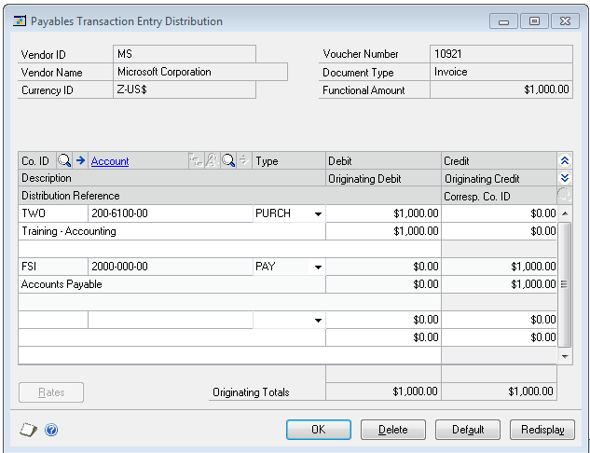
Structured Data
Attributes are labeled and distinctly visible.
Easily searchable and query able.
Stored easily in tables

Slide 115
Unstructured Data
The Mazda3 is on a very short list of compact cars that are available as a hatchback or a sedan. It also comes with two 6-speed transmissions -- manual or automatic -- and choice of two 4-cylinder engines -- a 155-horsepower 2.0-liter or a 184-horsepower 2.5-liter -- and all of those variations are available with either body style. Its best fuel economy is an EPA-rated 41 mpg on the highway, which is near the top of the class for gasoline-powered cars (tying the Honda Civic, yet another trait they share). That rating applies to the 2.0-liter engine, whether it's backed by a manual or automatic transmission.
Data is continuous text
Attributes are not distinctly labeled. They are present within the data.
Querying is not easy.

Slide 116
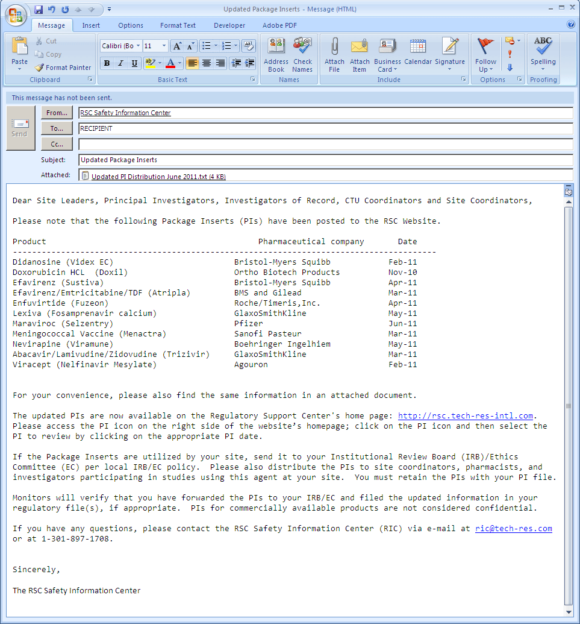
Semi-structured Data
Mix of structured and unstructured.
Some attributes are distinctly labeled. Others are hidden within free text

Slide 117
Summary
Entity
Characteristics
Environment
Event
Behavior
Outcomes
Observation
Dataset

Slide 118
Learning
Discovering knowledge from Data

Slide 119
Relationships
Attributes in a dataset exhibit relationships
Relationships “model” the real world and have a logical “explanation”
For attributes A and B the relationships can be
When A occurs, B also occurs
When A occurs B does not occur
When A increases B also increases
When A increases B decreases
Relationships can involve multiple attributes too
When A is present and B increases, C will decrease

Slide 120
Relationships - Examples
Customer
As age goes up, spending capacity goes up. ( AGE and REVENUE)
Urban customers buy more internet bandwidth ( LOCATION and BANDWIDTH)
Patient
Older patients have more prevalence of Diabetes ( AGE and DISEASE LEVEL)
Overweight patients typically have higher cholesterol levels ( WEIGHT and HDL)
Car
The more cylinders a car has, the mileage tends to be lower ( CYLINDERS and MILEAGE)
Sports Cars have more insurance rates ( TYPE and RATES)

Slide 121
Relationships
Consistent vs Incidental Patterns in Data
Correlations
Signals and noise

Slide 122
What is Learning
Learning implies learning about relationships.
It involves
Taking a domain
Understanding the attributes that represent the domain
Collecting data
Understanding relationships between the attributes
Model is the outcome of learning

Slide 123
Model
A simplified, approximated representation of a real world phenomenon
Captures key attributes and their relationships
Mathematical model – represents relationships as an equation
Blood Pressure
BP = 56 + ( AGE * .8) + ( WEIGHT * .14 ) + ( LDL * .009)
Decision Tree model – represents the outcome as a decision tree
Buying a music CD
If AGE < 25 and GENDER=MALE, buy BEYONCE-CD = YES
Accuracy of models depends on strength of relationships between attributes

Slide 124
Prediction
A model can be used to predict unknown attributes
BP = 56 + ( AGE * .8) + ( WEIGHT * .14 ) + ( LDL * .009)
The above model represents the relationships between BP, AGE, WEIGHT and LDL.
If 3 of the 4 attributes are known, the model can be used to predict the 4th.
The above equation can be considered the prediction algorithm
Relationships can be a lot more complex, leading to complex models and prediction algorithms.

Slide 125
Predictors and outcomes
Outcomes are attributes that you want to predict
Predictors are attributes that are used to predict outcomes.
Learning is all about building models that can be used to predict outcomes (outputs) using the predictors (inputs)
Example | Predictors | Outcomes
Customer | Age, Income Range, Location | Buy? Yes/No
Patient | Age, Blood Pressure, Weight | Diabetic?
Car | Cylinders, acceleration | Sports vs family

Slide 126
Humans vs machines
Humans understand relationships and predict all the time.
Build humans can only handle finite amount of data
One shop keeper can know preferences of 100 customers, not 10 million of them
Machines (computers) come into play when the number of entities and data about them are large
There in comes machine learning, predictive analytics and data science

Slide 127
So what is Data Science ?
Picking a problem in a specified domain
Understanding the problem domain (entities and attributes)
Collect datasets that represent the entities
Discover relationships ( Learning)
When computers are used for this purpose, its called machine learning.
Build models that represent relationships
Uses past data where all predictors and outcomes are known
Use models for predicting outcomes
Current/ future data – predictors known, outcomes unknown

Slide 128
Data Science Example – Website Shopper
Problem : Predict if the shopper will buy a smartphone
Data: Past purchase history of shoppers
Shopper characteristics (age, gender, income etc.)
Seasonal information
Others..
Build Model
Decision model based on shopper and seasonal entities
Built every week
Prediction
When a new shopper is browsing, predict if the shopper will buy
Action
Offer Chat help

Slide 129
Real Time Data Science

Slide 130
What is real time?
Faster processing
Real time Analytics
Real time model building
Real time predictions.

Slide 131
Real time processing with Spark
Connectors to real time streaming sources
Data can be cleansed and transformed in stream.
Stored in in-memory data stores –
Reporting/Analytics using Spark SQL or 3rd party tools

Slide 132
Real time model building
Not a real time activity
Models need a large corpus of data
Volume
Variety
Manually evaluated
Needs exploring different algorithms
Needs tuning.
Build once, use many

Slide 133
Real time predictions
Receive, cleanse and transform data in real time
Load a saved model and use it for prediction.
Store predictions in in-memory DB and use it for real time actions

Slide 134
Splitting work between Language and Spark
Use language
Receiving data
Storing data
Communicating with other systems
Use Spark
Data cleansing
Transformation
Model building
Predictions

Slide 135
Analytics and Predictions

Slide 136
Types of Analytics

Slide 137
Types of Analytics
Type of Analytics | Description
Descriptive | Understand what happened
Exploratory | Find out why something is happening
Inferential | Understand a population from a sample
Predictive | Forecast what is going to happen
Causal | What happens to one variable when you change another
Deep | Use of advanced techniques to understand large and multi-source datasets

Slide 138
Exploratory Data Analysis

Slide 139
Goals of EDA
Understand the predictors and targets in the data set
Spreads
Correlations
Uncover the patterns and trends
Find key variables and eliminate unwanted variables
Detect outliers
Validate previous data ingestion processes for possible mistakes
Test assumptions and hypothesis

Slide 140
Tools used for EDA
Correlation matrices
Boxplots
Scatterplots
Principal component Analysis
Histograms

Slide 141
Machine Learning
-

Slide 142
Overview
Data contains attributes
Attributes show relationships (correlation) between entities
Learning – understanding relationships between entities
Machine Learning – a computer analyzing the data and learning about relationships
Machine Learning results in a model built using the data
Models can be used for grouping and prediction

Slide 143
Data for machine learning
Machines only understand numbers
Text Data need to be converted to equivalent numerical representations for ML algorithms to work.
Number representation
(Excellent, Good, Bad can be converted to 1,2,3)
Boolean variables
3 new Indicator variables called Rating-Excellent, Rating-Good, Rating-Bad with values 0/1
Document Term matrix

Slide 144
Unsupervised Learning
Finding hidden structure / similarity / grouping in data
Observations grouped based on similarity exhibited by entities
Similarity between entities could be by
Distance between values
Presence / Absence
Types
Clustering
Association Rules Mining
Collaborative Filtering

Slide 145
Supervised Learning
Trying to predict unknown data attributes (outcomes) based on known attributes ( predictors) for an entity
Model built based on training data (past data) where outcomes and predictors are known
Model used to predict future outcomes
Types
Regression ( continuous outcome values)
Classification (outcome classes)

Slide 146
Supervised Learning Process
Training Set
Learning
Historical Data (predictors + outcomes)
Model
New Data (predictors)
Testing Set
Test
Outcomes
Predict
Final Model

Slide 147
Training and Testing Data
Historical Data contains both predictors and outcomes
Split as training and testing data
Training data is used to build the model
Testing data is used to test the model
Apply model on testing data
Predict the outcome
Compare the outcome with the actual value
Measure accuracy
Training and Test fit best practices
70-30 split
Random selection of records. Should maintain data spread in both datasets

Slide 148
Comparing Results

Slide 149
Confusion Matrix
Plots the predictions against the actuals for the test data
Helps understand the accuracy of the predictions
Predictions can be Boolean or classes
 |  | Actual
 |  | TRUE | FALSE | Total
Predict ion | TRUE | 44 | 6 | 50
 | FALSE | 9 | 41 | 50
 | Total | 53 | 47 | 100

Slide 150
Prediction Types
The importance of prediction types vary by the domain
True Positive (TP) and True Negative (TN) are the correct predictions
False Negative (FN) can be critical in medical field
False Positive (FP) can be critical in judicial field
 |  | Actual
 |  | TRUE | FALSE
Predict ion | TRUE | True Positive | False Positive
 | FALSE | False Negative | True Negative

Slide 151
Confusion Matrix metrics
Accuracy
Measures the accuracy of the prediction
Accuracy = (TP + TN) / ( TP + TN + FP + FN)
Sensitivity
Hit rate or recall
Sensitivity = TP / ( TP + FN)
Specificity
True negative rate
Specificity = TN / (TN + FP)
Precision
Precision = TP / (TP + FP)
 |  | Actual
 |  | TRUE | FALSE
Predict ion | TRUE | True Positive | False Positive
 | FALSE | False Negative | True Negative

Slide 152
Prediction Errors

Slide 153
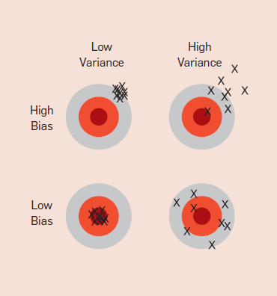
Bias and Variance
Bias happens when the model “skews” itself to certain aspects of the predictors, while ignoring others. It is the error between prediction and actuals.
Variance refers to the stability of a model – Keep predicting consistently for new data sets. It is the variance between predictions for different data sets.

Slide 154
Types of Errors
In-Sample error is the prediction error when the model is used to predict on the training data set it is built upon.
Out-of-sample error is the prediction error when the model is used to predict on a new data set.
Over fitting refers to the situation where the model has very low in-sample error, but very high out-of-sample error. The model has “over fit” itself to the training data.

Slide 155
Machine Learning with Spark

Slide 156
Overview
Make ML practical and easy.
Contains algorithms and utilities
Packages
spark.mllib – original APIs built on RDDs
spark.ml – new higher level API built on DataFrames (Spark SQL) and pipelines
http://spark.apache.org/docs/latest/ml-guide.html
Special data types
Local vector
Labeled Point

Slide 157
Local Vector
A vector of double values
Dense Vector
(1.0, 3.0, 4.5)
Sparse Vector
Original : (1.0,0.0,0.0,2.0,0.0)
Representation: (5, (0,3), ( 1.0,2.0)

Slide 158
Labeled Point
Represents a Data point in ML
Contains a “label” (the target variable) and a list of “features” (the predictors)
LabeledPoint(1.0, Vectors.dense(1.0,0.0,3.0) )

Slide 159
Pipelines
A pipeline consist of a series of transformations and actions that need to be performed to create a model
DataFrame (the source)
Transformers (data transformations)
Estimators (model building)
Parameters (common parameters across algorithms)
Internally optimized for better parallelism and resource utilization

Slide 160
Typical Spark ML workflow
Load data into RDD
Transform RDD
Filtering features
Strings to float
Indicator variables
Centering and Scaling
Convert to LabeledPoint and create a DataFrame (label, features)
Split training and testing
Create model
Perform predictions.

Slide 161
Linear Regression
Linear Relationships

Slide 162
Regression Analysis
Method of investigating functional relationship between variables
Estimate the value of dependent variables from the values of independent variables using a relationship equation
Used when the dependent and independent variables are continuous and have some correlation.
Goodness of Fit analysis is important.

Slide 163
Linear Equation
X is the independent variable
Y is the dependent variable
Compute Y from X using
Y = αX + β
Coefficients:
α = Slope = Y/X
β = Intercept = value of Y when X=0

Slide 164
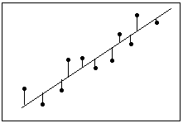
Fitting a line
Given a scatter plot of Y vs X, fit a straight line through the points so that the sum of square of vertical distances between the points and the line (called residuals) is minimized
Best line = least residuals
A line can always be fitted for any set of points
The equation of the line becomes the predictor for Y

Slide 165
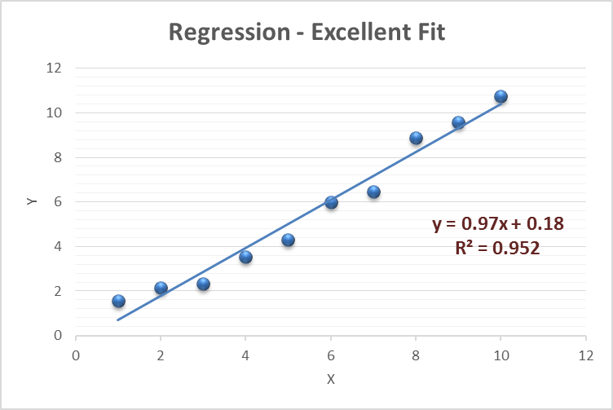
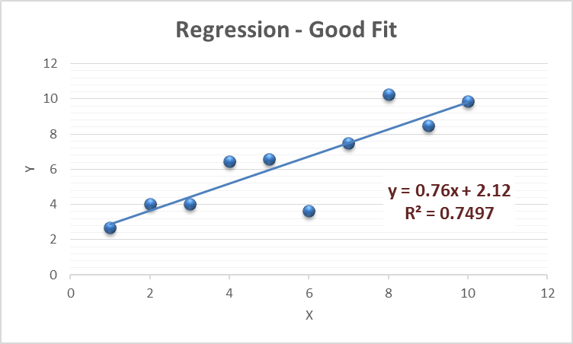
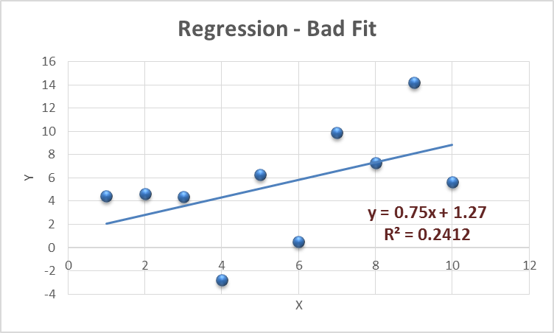
Goodness of Fit
R-squared measures how close the data is to the fitted line
R-squared varies from 0 to 1. The higher the value, the better the fit
You can always fit a line. Use R-squared to see how good the fit is
Higher correlation usually leads to better fit

Slide 166
Multiple regression
When there are more than one independent variable that is used to predict the dependent variable.
The equation Y = β + α ₁*X₁ + α ₂*X₂ + ... + α _{p}*X_{p}
Same process used for prediction as a single independent variable
Different predictors have different levels of impact on the dependent variable

Slide 167
Using Linear Regression for ML
ML Technique to predict continuous data – supervised learning
Predictors and outcomes provided as input
Data analyzed (training) to come up with a linear equation
Coefficients
Intercept
R-squared
Linear equation represents to model.
Model used for prediction
Typically fast for model building and prediction

Slide 168
Summary – Linear Regression
Advantages
Fast
Low cost
Excellent for linear relationships
Relatively accurate Continuous variables
Shortcomings
Only numeric/ continuous variables
Cannot model non-linear / fuzzy relationships
Sensitive to outliers
Used in
Oldest predictive model used in a wide variety of applications to predict continuous values

Slide 169
Decision Trees

Slide 170
Overview
The simplest, easy to understand and easy to explain ML technique.
Predictor variables are used to build a tree that would progressively predict the target variable
Trees start with a root node that start the decision making process
Branch nodes refine the decision process
Leaf nodes provide the decisions
Training data is used to build a decision tree to predict the target
The tree becomes the model that is used to predict on new data

Slide 171
Example
Age > 41 ?
Age | BMI | Is Diabetic
24 | 22 | N
33 | 28 | N
41 | 36 | Y
48 | 24 | N
58 | 31 | Y
61 | 35 | Y
No
Yes
BMI > 28 ?
BMI > 24 ?
No
Yes
No
Yes
N
Y
N
Y
Predicting “Is Diabetic ?”

Slide 172
Choosing the right Predictors
The depth of trees are highly influenced by the sequence in which the predictors are chosen for decisions
Using predictors with high selectivity gives faster results
ML implementations automatically make decisions on the sequence /preference of predictors

Slide 173
Summary – Decision Trees
Advantages
Easy to interpret and explain
Works with missing data
Sensitive to local variations
Fast
Shortcomings
Limited Accuracy
Bias builds up pretty quickly
Not good with large predictors
Used in
Credit approvals
Situations with legal needs to explain decisions
Preliminary categorization

Slide 174
Naïve Bayes

Slide 175
Bayes’ theorem (too) simplified
Probability of an event A = P(A) is between 0 and 1
Bayes’ theorem gives the conditional probability of an event A given event B has already occurred.
P(A/B) = P(A intersect B ) * P (A) /P(B)
Example
There are 100 patients
Probability of a patient having diabetes is P(A) = .2
Probability of patient having diabetes (A) given that the patient’s age is > 50 (B) is P(A/B) = .4

Slide 176
Naïve Bayes Classification
Application of Bayes’ theorem to ML
The target variable becomes event A
The predictors become events B1 – Bn
We try to find P(A / B1-Bn)
Age | BMI | Is Diabetic
24 | 22 | N | Probability of Is Diabetic = Y given that Age = 24 and BMI = 22
41 | 36 | Y | Probability of Is Diabetic – Y given that Age = 41 and BMI = 36

Slide 177
Model building and prediction
The model generated stores the conditional probability of the target for every possible value of the predictor.
When a new prediction needs to be done, the conditional probabilities are applied using Bayes’ formula to find the probability
To predict for Age = 25
P( Salary < 50K / Age=25 ) = 0.3 * 0.75 / 0.24 = ~ 0.92
P( Salary > 50K / Age=25 ) = 0.08 * 0.25 / 0.24 = ~ 0.08
 | Overall | Age |  |  |  |  |  | Gender
Salary |  | 1 to 20 | 20 to 30 | 30 to 40 | 40 to 50 | 50 to 60 | 60 to 100 | Female | Male
< 50K | .75 | 0.1 | 0.3 | 0.25 | 0.17 | 0.1 | 0.08 | 0.39 | 0.61
> 50K | .25 | 0.03 | 0.08 | 0.3 | 0.32 | 0.2 | 0.07 | 0.15 | 0.85
Overall |  | .08 | .24 | .26 | .21 | .12 | .08 | .33 | .67

Slide 178
Summary – Naïve Bayes
Advantages
Simple and fast
Works well with noisy and missing data
Provides probabilities of the result
Very good with categorical data
Shortcomings
Limited Accuracy
Expects predictors to be independent
Not good with large numeric features
Used in
Medical diagnosis
Spam filtering
Document classification
Sports predictions

Slide 179
Random Forests

Slide 180
Overview
Random Forest is one of the most popular and accurate algorithms
It is an Ensemble method based on decision trees
Builds multiple models – each model a decision tree
For prediction – each tree is used to predict an individual result
A vote is taken on all the results to find the best answer

Slide 181
How it works
Lets say the dataset contains m samples (rows) and n predictors (columns)
x trees are built, each with a subset of data
For each tree, a subset of m rows and n columns are chosen randomly.
For example, if the data has 1000 rows and 5 columns, each tree is built using 700 rows and 3 columns
The data subset is used to build a tree
For prediction, new data is passed to each of the x trees and x possible results obtained
For example, if we are predicting buy=Y/N and there are 500 trees, we might get 350 Y and 150 N results
The most found result is the aggregate prediction.

Slide 182
Summary – Random Forest
Advantages
Highly accurate
Efficient on large number of predictors
Fully parallelizable
Very good with missing data
Shortcomings
Time and Resource consuming
For categorical variables, bias might exist if levels are disproportionate
Used in
Scientific Research
Competitions
Medical Diagnosis

Slide 183
K-means Clustering

Slide 184
Overview
Unsupervised Learning technique
Popular method for grouping data into subsets based on the similarity
Partitions n observations with m variables into k clusters where by each observation belongs to only one cluster
How it works
An m dimensional space is created
Each observation is plotted based on this space based on the variable values
Clustering is done by measuring the distance between points and grouping them
Multiple types of distance measures available like Euclidian distance and Manhattan distance

Slide 185
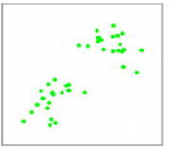
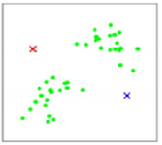
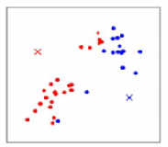
Clustering - Stages
Dataset contains only m=2 variables. We will create k=2 clusters
Plot observations on a two dimensional plot
Choose k=2 centroids at random
Measure the distance between each observation to each centroid
Assign each observation to the nearest centroid
This forms the clusters for round 1

Slide 186
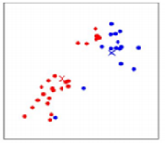
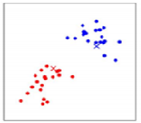
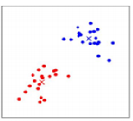
Clustering - Stages
Find the centroid of each of the cluster
Centroid is the point where the sum of distances between the centroid and each point is minimum
Repeat the process of finding the distance between each observation to each centroid (the new one) and reassign each point to the nearest one
Find the centroid for the new clusters
Repeat the process until the centroids don’t move

Slide 187
Summary – K-means clustering
Advantages
Fast
Efficient with large number of variables
Explainable
Shortcomings
K needs to be known
The initial centroid position has influence on clusters formed
Used in
Preliminary grouping of data before other classification
General grouping
Geographical clustering

Slide 188
Collaborative Filtering

Slide 189
Association Rules Mining

Slide 190
Overview
ARM shows how frequently sets of items occur together
Find Items frequently brought together
Find fraudulent transactions.
Frequent Pattern Mining/ Exploratory Data Analysis
Finding the next word
One of the clustering techniques
Assumes all data are categorical, not applicable for numeric data
Helps generate association rules that can be then used for business purposes like stocking aisles.

Slide 191
Datasets
Market basket transactions
Tran 1 { bread, cheese, milk}
Tran 2 { apple, eggs, yogurt}
Tran 3 {bread, eggs}
Text document data set ( bag of words)
Doc 1 { cricket, sachin, India }
Doc 2 { soccer, messi, Barcelona}
Doc 3 { sachin, messi, superstars}

Slide 192
ARM measures
Let N be the number of transactions
Let X, Y and Z be individual items
Support measures how frequently an combination of items occurs in the transactions
Support(X) = count(transactions with X)/ N
Support(X,Y)= count(transactions with X and Y)/N
Confidence measures the expected probability that Y would occur when X occurs
Confidence(X -> Y) = support(X,Y) / support(X)
Lift measures how many more times X and Y occurs together than expected
Lift( X -> Y) = confidence(X->Y) / support(Y)

Slide 193
Rules and goals
A rule specifies when one item occurs the other too occurs
When bread is brought, milk is brought 33% of the time.
When India occurs in the bag of words, sachin occurs 20% of the time.
Goal is to find all rules that satisfy the user specified minimum support and minimum confidence
A frequent itemset is an itemset whose support is > the minimum support level specified.
Apriori algorithm is the most popular ARM algorithm

Slide 194
Data Formats
Transaction form
a, b, c
a, c, d, e
a, d
Table form
Attr1, Attr2, Attr 3
A B C
A C D
Table should be converted to transaction
(Attr1 = A), (Attr2 = B), (Attr3 = C)
(Attr1 = A), (Attr2 = C), (Attr3 = D)

Slide 195
Dimensionality Reduction
Principal Component Analysis

Slide 196
Issues with too many predictors
Memory requirements
CPU requirements / time taken for machine learning algorithms
Correlation between predictors
Over fitting
Some ML algorithms don’t work fine with too many predictors

Slide 197
Manual selection
Using domain knowledge
Purely based on hypothesis
Risky – there could be unknown correlations
Using Correlation co-efficients
Variables with good correlation can only be picked up.
Using Decision Trees
Decision trees are fast and choose variables based on correlation
Variables used in the decision trees can be picked for further processing

Slide 198
Principal Component Analysis
Used to reduce the number of predictors
Based on Eigen Vectors and Eigen Values.
Given a set of M predictors, PCA transforms this to a set of N predictors such that N < M
The new predictors are derived predictors called PC1, PC2, PC3
The new predictors retain similar levels of correlation and predictability like the original predictors

Slide 199
Big Data Analytics with Spark and Scala

Slide 200
Course goal
Train students to kick start their journey with Big Data Analytics with Apache Spark with simple explanations and easy to do exercises

Slide 201
Why learn Apache Spark?
Hottest tool /product in the Big Data Analytics field.
Used by more and more companies for Analytics and Machine Learning
Hadoop/Map Reduce applications migrating to Spark
More and more third party support
Huge current and forecasted demand for skilled professionals

Slide 202
What you achieve by taking this course
Understand the concepts and life cycle of Data Science and Analytics
Develop proficiency to use Apache Spark for all stages of analytics
Learn Data Engineering tools and techniques with Spark
Acquire knowledge of different machine learning techniques and know when and how to use them.
Become a full-fledged Big Data Analyst who can immediately contribute to real-life Analytics projects

Slide 203
Course Structure
Hadoop and Spark Concepts
Interactive Programming with Scala
Spark Programming including Spark SQL and Spark Streaming
Basics of Real Time Data Science
Machine Learning with Spark
End-to-End use cases
Resource Bundle

Slide 204
Things not covered
Object Oriented Scala
Spark Cluster setup and administration
Running Spark on a cluster

Slide 205
Guidelines to students
Machine Learning and Data Science is a complex subject. Needs significant efforts to understand it.
Review and re-review videos and exercises
Seek out other help – books, online documentations, support forums
If you have queries, doubts or concerns, please send a private message or post a discussion question
We would be happy to address them as soon as possible
We are constantly improving our courses so all feedback is welcome
Feedback through private messages / emails.
At the end of the course, if you like it, please leave a review

Slide 206
Relationship with other V2 Maestros courses
Our courses are focused on Data Science related topics
Technologies
Processes
Tools and Techniques
We focus on making our courses self sufficient
If you are an existing V2 Maestros student, you will see some content and examples repeated across courses

Slide 207
We hope this course helps you to advance your career.
Best of luck !

Slide 208
Big Data Analytics with Apache Spark and Scala
Closing Remarks

Slide 209
Course Structure
Hadoop and Spark Concepts
Interactive Programming with Scala
Spark Programming including Spark SQL and Spark Streaming
Basics of Real Time Data Science
Machine Learning with Spark
End-to-End use cases
Resource Bundle

Slide 210
Next Steps
Continue to learn on Data Science
Big Data
Try exercises with new data sets
UCI Data sets
Kaggle
Crowd analytics
Interviews
Focus on process

Slide 211
Congratulations on finishing this course !
We hope this course helps you to advance your career.
Best of luck !

